Slide 1
SECURE DATA HIDING IN IMAGES USING steganography
BALABOMMA HEMANTH
NRI INSTITUTE OF TECHNOLOGY
MECHANICAL ENGINEERING

Slide 2
OUTLINE
Problem Statement
Technology used
Wow factor
End users
Result
Conclusion
Git-hub Link
Future scope

Slide 3
Problem Statement
In today's digital world, securing sensitive information is more important than ever. Encryption protects data but can attract unwanted attention.With the increase in digital communication, keeping data secure is a big challenge. Encryption protects data but can attract attention. Steganography helps by hiding data inside images without making it obvious. This project aims to create a secure method to hide and retrieve data in images. The goal is to ensure the hidden data stays safe while keeping the image quality unchanged.Steganography allows data to be hidden inside images without being noticed. This project aims to develop a secure way to hide and retrieve data in images. The goal is to keep the data.

Slide 4
Technology used
Technologies Used in Secure Data Hiding Using Steganography
1. Programming Language: Python – for implementing steganography techniques.
2. Development Environment: IDLE, PyCharm, or Jupyter Notebook – for writing and testing code.
3. Libraries & Tools:
- OpenCV– for image processing.
- Stegano– for easy steganography implementation.
4. Encryption Methods: AES or RSA for additional security before hiding data.
5. GUI Development: Tkinter or PyQt for a user-friendly interface (if needed).
These technologies help in securely hiding and extracting data from images.

Slide 5
Wow factors
Wow Factors of Secure Data Hiding Using Steganography
Invisible Data Storage – Hidden data is undetectable to the human eye, making it highly secure.
Dual Protection – Combines encryption with steganography for extra security.
Minimal Image Quality Loss – Ensures the cover image looks almost unchanged.
Resistance to Attacks – Protects hidden data from steganalysis, compression, and noise.
User-Friendly Implementation – Simple GUI for easy hiding and retrieving of data.
Real-World Applications – Useful in secure communication, digital watermarking, and copyright protection.

Slide 6
End users
Applications of Secure Data Hiding Using Steganography
Secure Communication – Used to secretly transmit confidential messages without detection.
Data Protection – Helps in storing sensitive information safely within images.
Digital Watermarking – Protects intellectual property by embedding ownership details in media.
Anti-Piracy Measures – Prevents unauthorized copying of digital content.
Medical Data Security – Stores patient records securely within medical images.
Defense and Intelligence – Used for covert communication in military and espionage.
Forensic Investigation – Helps investigators secretly embed important case data in images.
Steganography is widely used for security, privacy, and copyright protection across various industries.

Slide 7
Results
Expected Result of Secure Data Hiding Using Steganography
Successful Data Hiding & Extraction – The system should securely embed and retrieve hidden data from images.
High Security & Undetectability – The hidden data should not be noticeable to the human eye or easy to detect through analysis.
Minimal Image Distortion – The cover image should look almost the same after embedding the data.
Efficient Performance – The process should be fast and work smoothly for different image sizes.
Data Integrity – The extracted data should be accurate and unaltered, ensuring no loss of information.
This project will provide a secure, reliable, and efficient way to hide sensitive information in images!

Slide 8
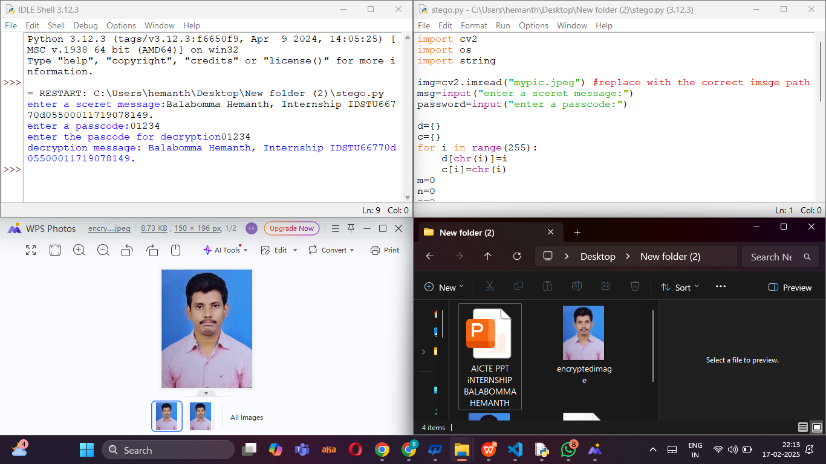

Slide 9
Conclusion
This project successfully implements secure data hiding using steganography, ensuring confidential information is embedded in images without noticeable changes. By combining encryption with steganography, it enhances security and prevents unauthorized access. The method maintains image quality while allowing efficient data retrieval. With applications in secure communication, digital watermarking, and data protection, this technique proves to be highly useful. Overall, the project provides a reliable, efficient, and secure way to hide sensitive information in images.

Slide 10
GitHub Link
https://github.com/Hemanth24-cloud/Steganography.git

Slide 11
Future scopE
Enhanced Security – Implement advanced encryption techniques like AES-256 for stronger data protection.
AI & Machine Learning Integration – Use AI to detect and prevent steganalysis attacks.
Support for Multiple Media Types – Extend steganography to videos, audio files, and documents.
Cloud-Based Steganography – Develop a secure cloud platform for remote data hiding and retrieval.
Real-Time Steganography – Enable secure live communication using hidden messages in real-time images or videos.
Mobile Application – Develop a user-friendly mobile app for secure data hiding and extraction.
These future advancements will make steganography even more secure, efficient, and widely applicable.

Slide 12
THANK YOU
BALABOMMA HEMANTH

